Slide 1
CSC 433/533
Computer Graphics
Alon Efrat
Credit: Joshua Levine
November 10
Today: More transformations and viewing

Slide 2
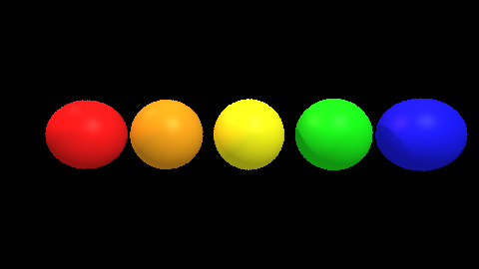
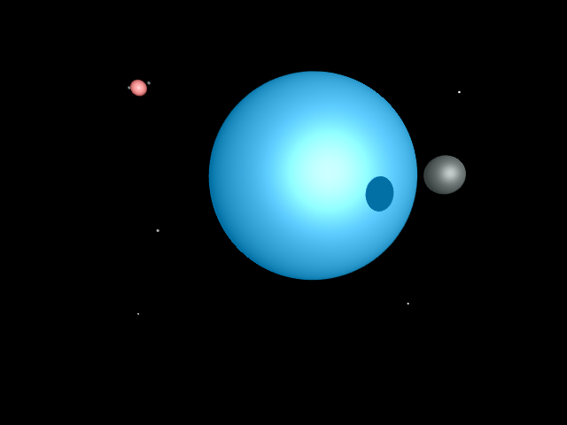
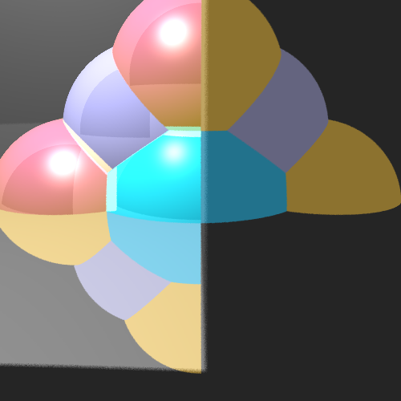
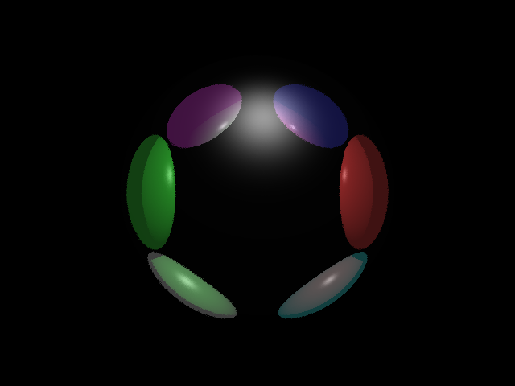
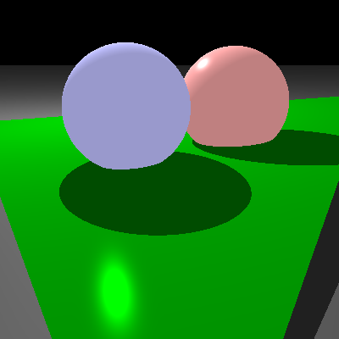

Slide 3
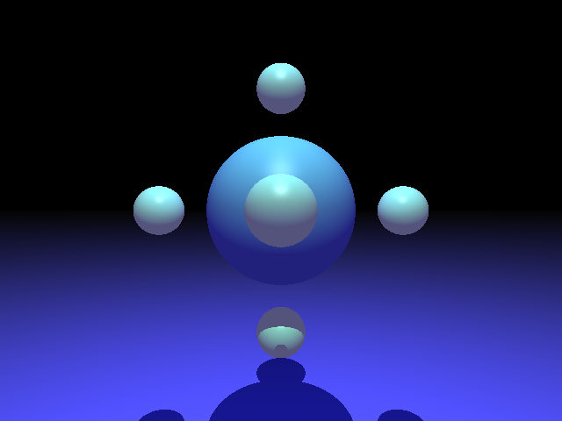

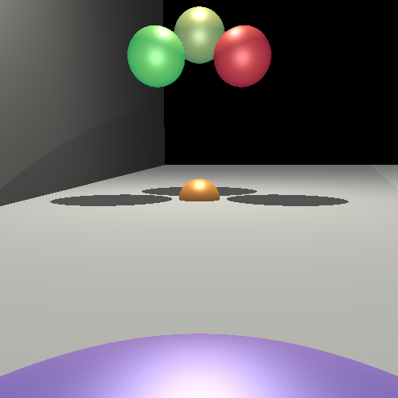
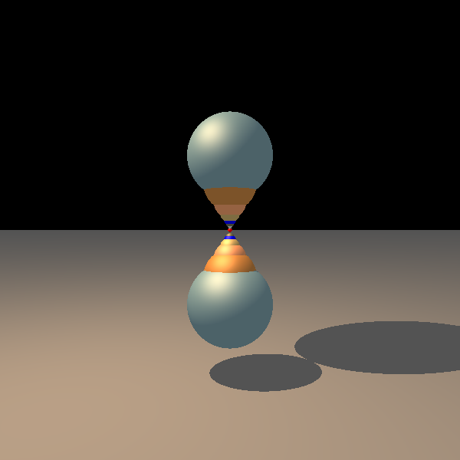

Slide 4
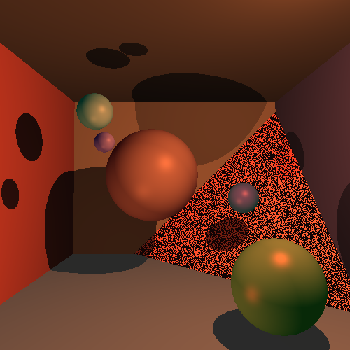

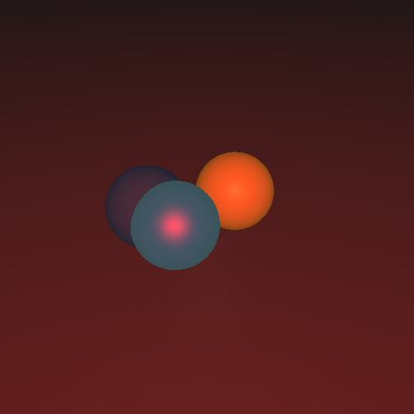

Slide 5

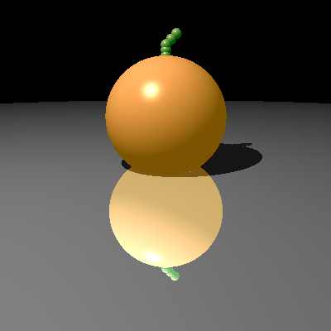
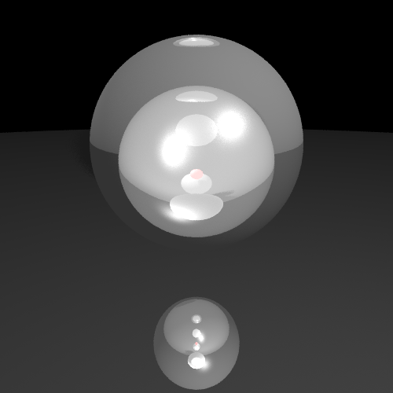
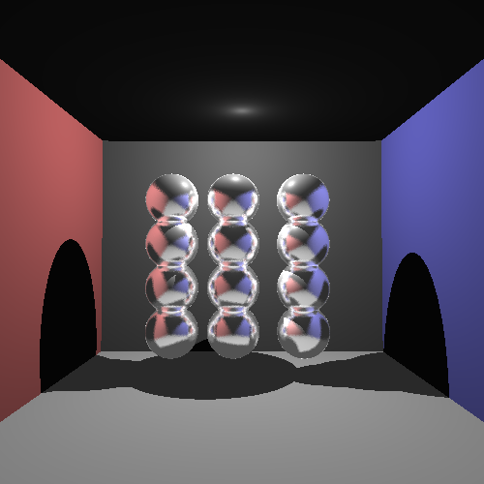

Slide 6
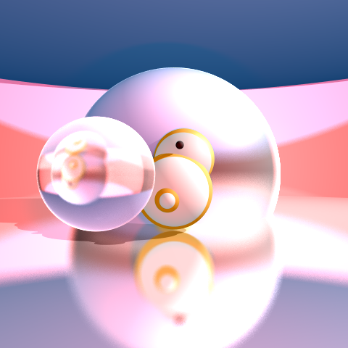


Slide 7
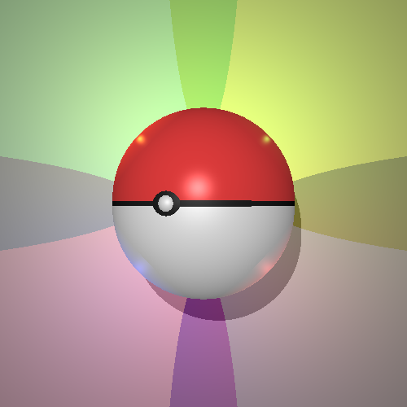
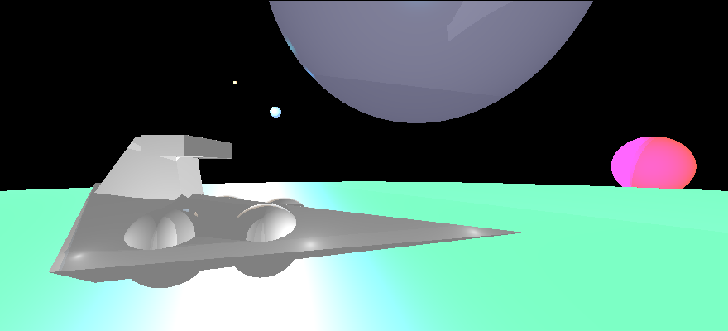

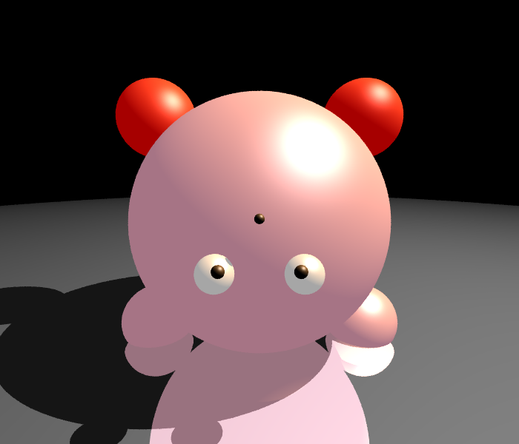

Slide 8
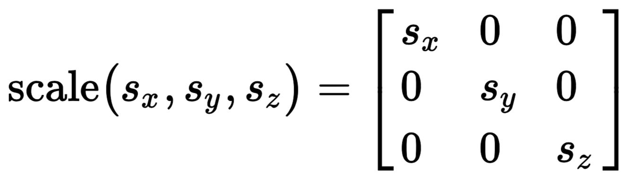
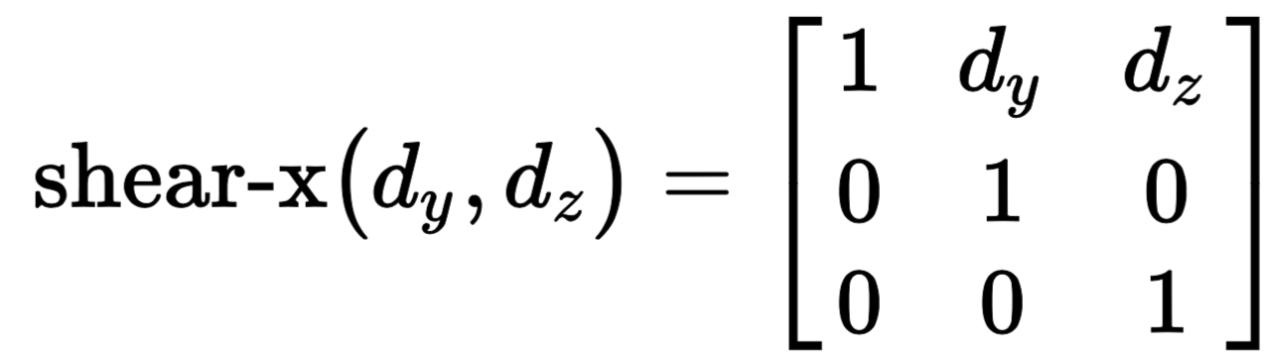
3D Linear Transformations
We can transform points in a 3D coordinate system by multiplying the point (a vector) by a matrix (the transformation), just like in 2D!
The only difference is we will use 3x3 matrices A by x = (x,y,z), or Ax, e.g. for scale and shear:

Slide 9
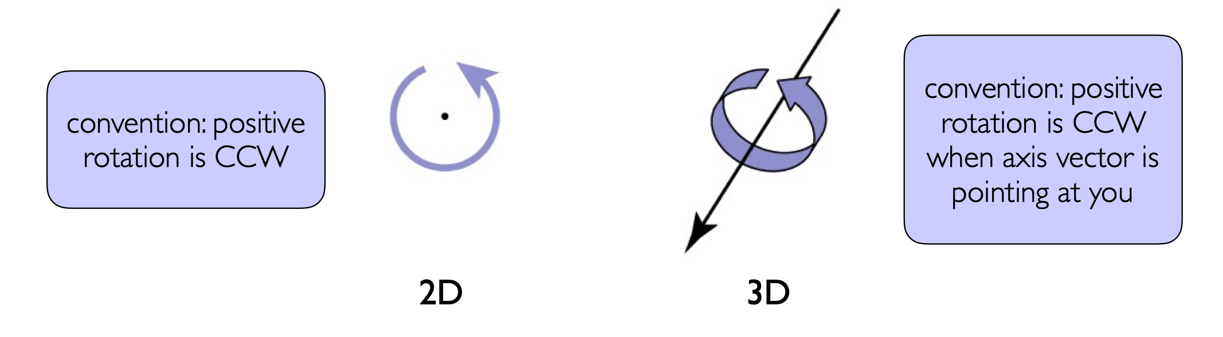
Rotations in 3D
In 2D, a rotation is about a point
In 3D, a rotation is about an axis

Slide 10
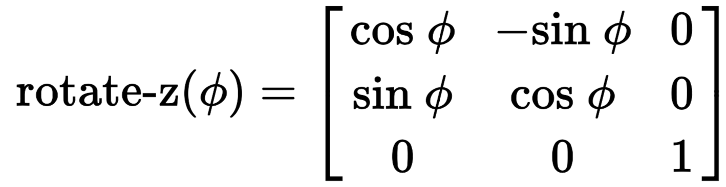
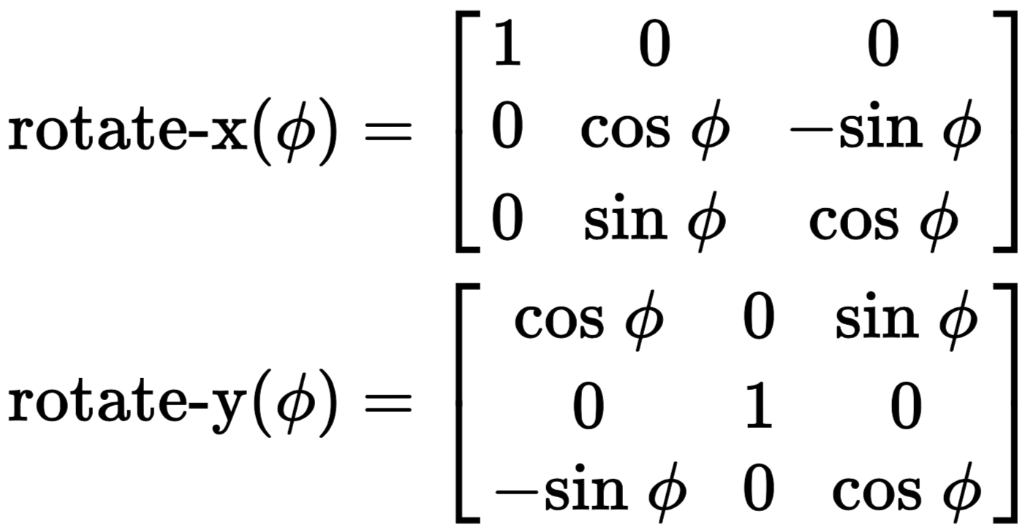
Rotations about 3D Axes
In 3D, we need to pick an axis to rotate about
And we can pick any of the three axes

Slide 11
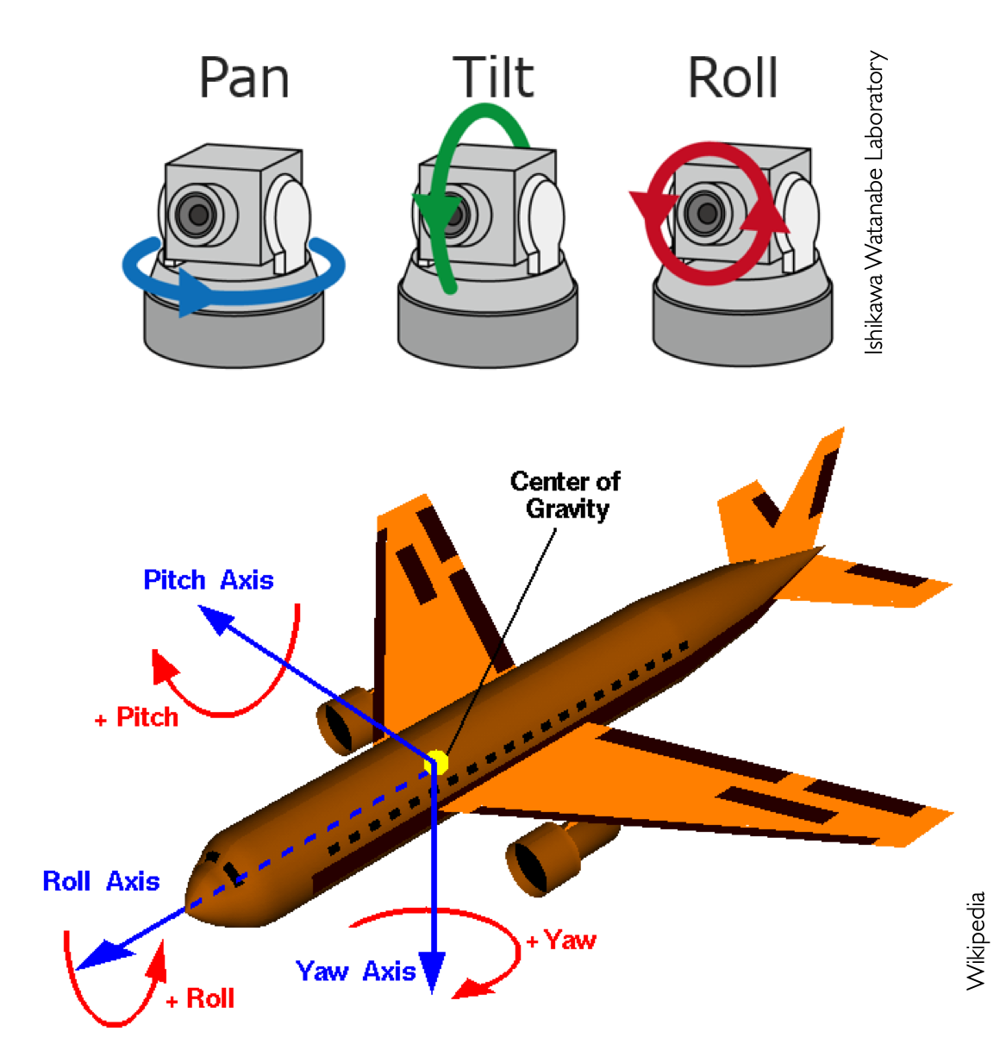
Building Complex Rotations from Axis-Aligned Rotations
Rotations about x, y, z are sometimes called Euler angles
Build a combined rotation using matrix composition

Slide 12
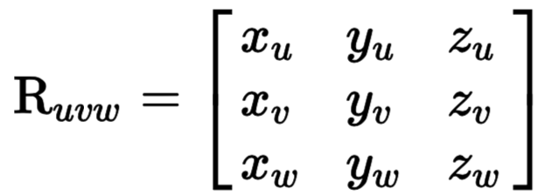
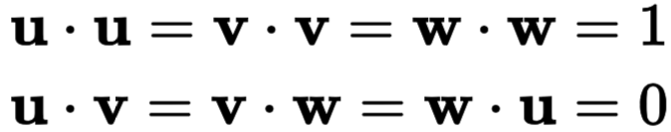
Arbitrary Rotations
To rotate about any axis: we change the coordinate space we are working in, using orthogonal matrices.
Consider orthogonal matrix Ruvw, form by taking three orthogonal vectors 𝐮, 𝐯, and 𝐰:
𝐮
Property of orthogonal vectors:
𝐯
𝐰

Slide 13
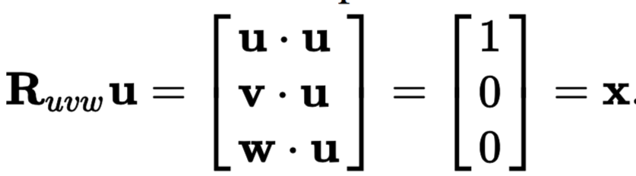
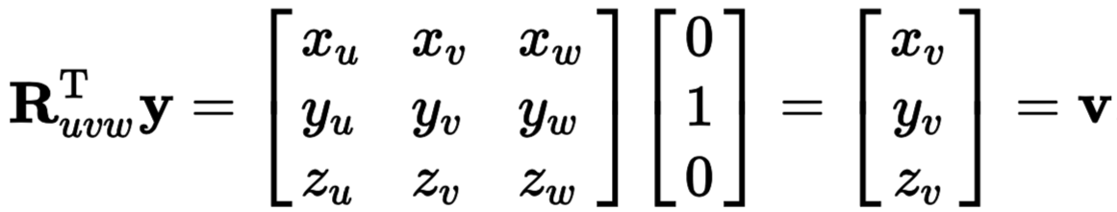
Arbitrary Rotations
What happens when we apply Ruvw to any of the basis vectors, e.g.:
But this means that if we apply Ruvw^{𝐓} to the Cartesian coordinate vectors, e.g.:

Slide 14
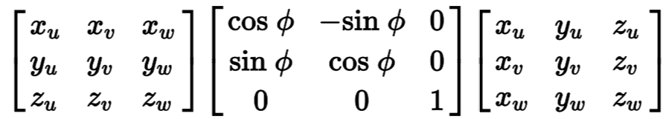
Arbitrary Rotations
This means that if we want to rotation around an arbitrary axis, we need only to use a change of coordinates
E.g. to rotate around a direction 𝐰, we
Compute orthogonal directions 𝐮, 𝐯, and 𝐰. All unit vectors.
Change the 𝐮𝐯𝐰 axes to be xyz (Ruvw)
Apply a rotate-z()
Finally, change the axes back to 𝐮𝐯𝐰 (Ruvw^{𝐓})
Ruvw^{𝐓}
rotate-z()
Ruvw
Notation: xu is the x-coordinate of the vector u

Slide 15
Coordinate Transformations

Slide 16
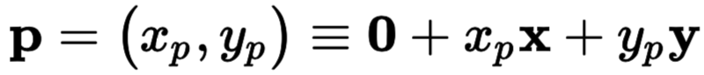
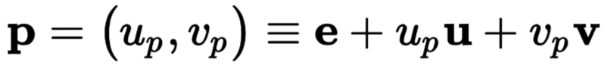
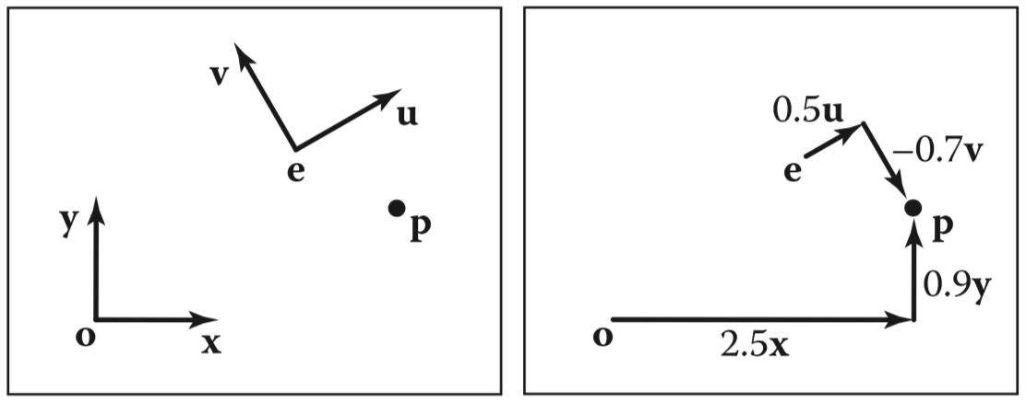
Coordinate Systems
Points in space can be represented using an origin position and a set of orthogonal basis vectors:
Any point can be described in either coordinate system

Slide 17
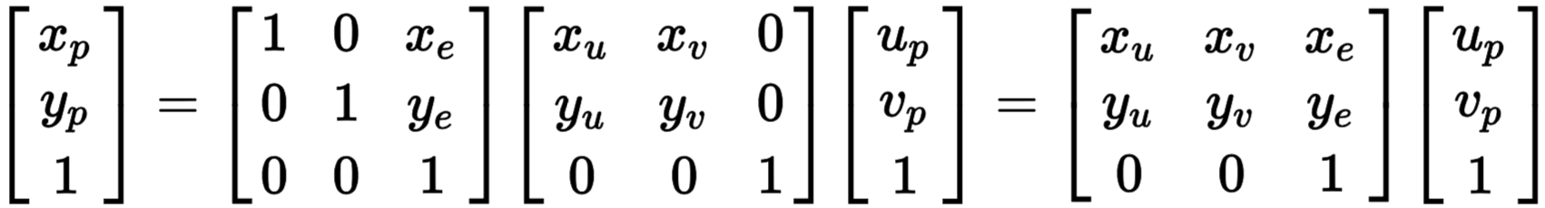
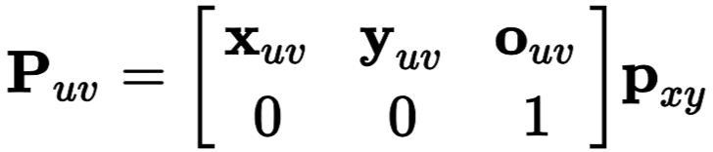
Matrices for Converting Coordinate Systems
(Remember: Rotating the world CCW is equivalent to rotating the coordinate system CW)
Using homogenous coordinates and affine transformations, we can convert between coordinate systems:
More generally, any arbitrary coordinate system transform:

Slide 18
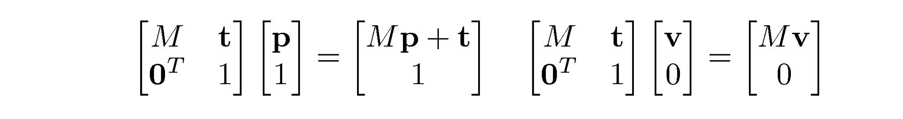
Transforming Points vs. Transforming Vectors
Using homogeneous coordinates, we can differentiate between points and vectors
Recall:
Vectors are just offsets (differences between points), and thus should be not affected by translation
Whereas points are represented by vectors offset from the origin
Rule: vectors have w=0, whereas points have w=1:

Slide 19
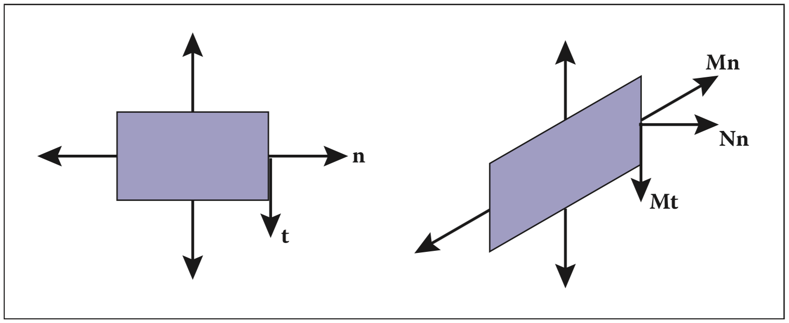
Transforming Normals
While differences between points (i.e. tangent vectors 𝐭) transform OK, normals do not necessarily behave the same

Slide 20
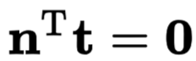
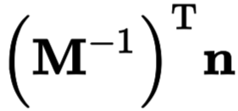
Transforming Normals
The problem is that the orthogonality constraint, that normals always point orthogonal to the surface, is not always preserved.
One can solve for the correct transformation by observing that tangent vectors, 𝐭, transform correctly and 𝐭・𝐧 = 0.
So, we can transform normals using the inverse matrix

Slide 21
Coordinate Transformations

Slide 22
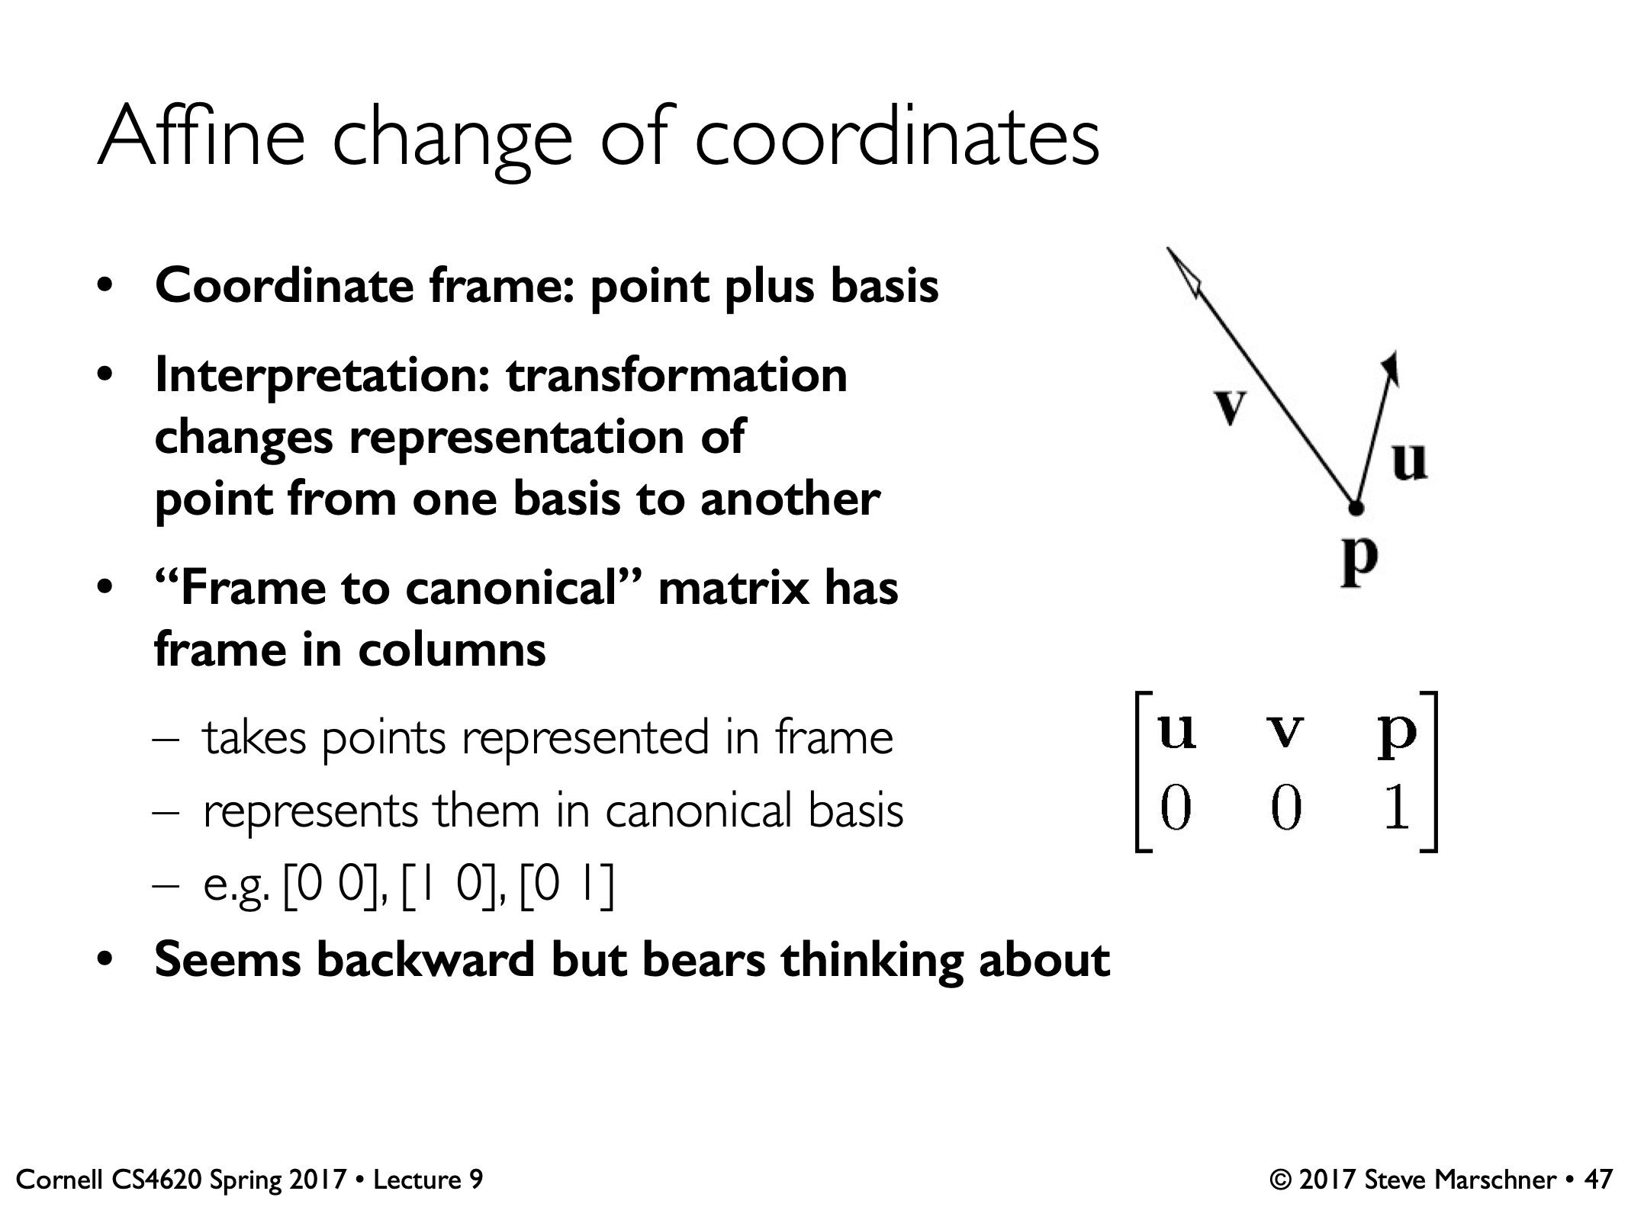
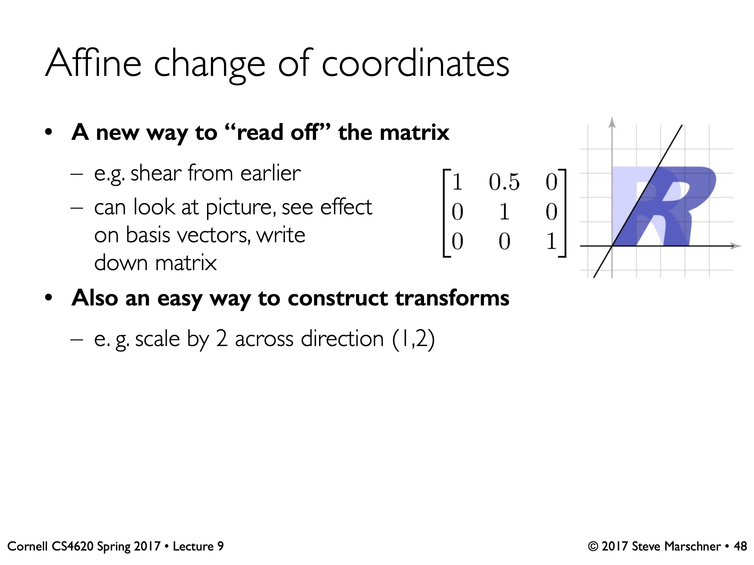
Affine Change of Coordinates
It turns out this works even if u, v are not orthogonal.
Change of coordinates provides another way to interpret and construct transformation matrices
Frame matrix
(converts x,y to u,v)

Slide 23
Viewing

Slide 24
Recall: Two Ways to Think About How We Make Images
Drawing
Photography

Slide 25
Recall: Two Ways to Think About Rendering
Object-Ordered
Decide, for every object in the scene, its contribution to the image
Image-Ordered
Decide, for every pixel in the image, its contribution from every object
TODAY

Slide 26
Coordinate Systems
Points in space can be represented using an origin position and a set of orthogonal basis vectors:
Any point can be described in either coordinate system

Slide 27
Matrices for Converting Coordinate Systems
(Remember: Rotating the world CCW is equivalent to rotating the coordinate system CW)
Using homogenous coordinates and affine transformations, we can convert between coordinate systems:
More generally, any arbitrary coordinate system transform:

Slide 28
View Transformations

Slide 29
Using Transformations for Rendering
Idea for today: Matrices can be used to move objects from 3D spaces to the 2D space of an image
Broadly, this reduction of dimensions is called viewing transformation
We will compose multiple matrix-based transformations to rethink cameras

Slide 30

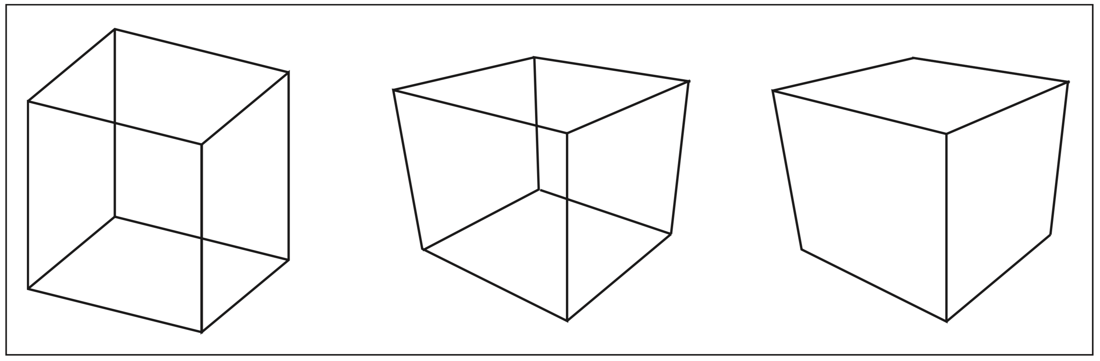
Drawing by Transformation
For now, we will consider drawing wireframe objects (collections of 3D line segments)
Perspective
farther objects looks smaller
Parallel lines might meet
Orthographic
Perspective +
Hidden Line Removal

Slide 31
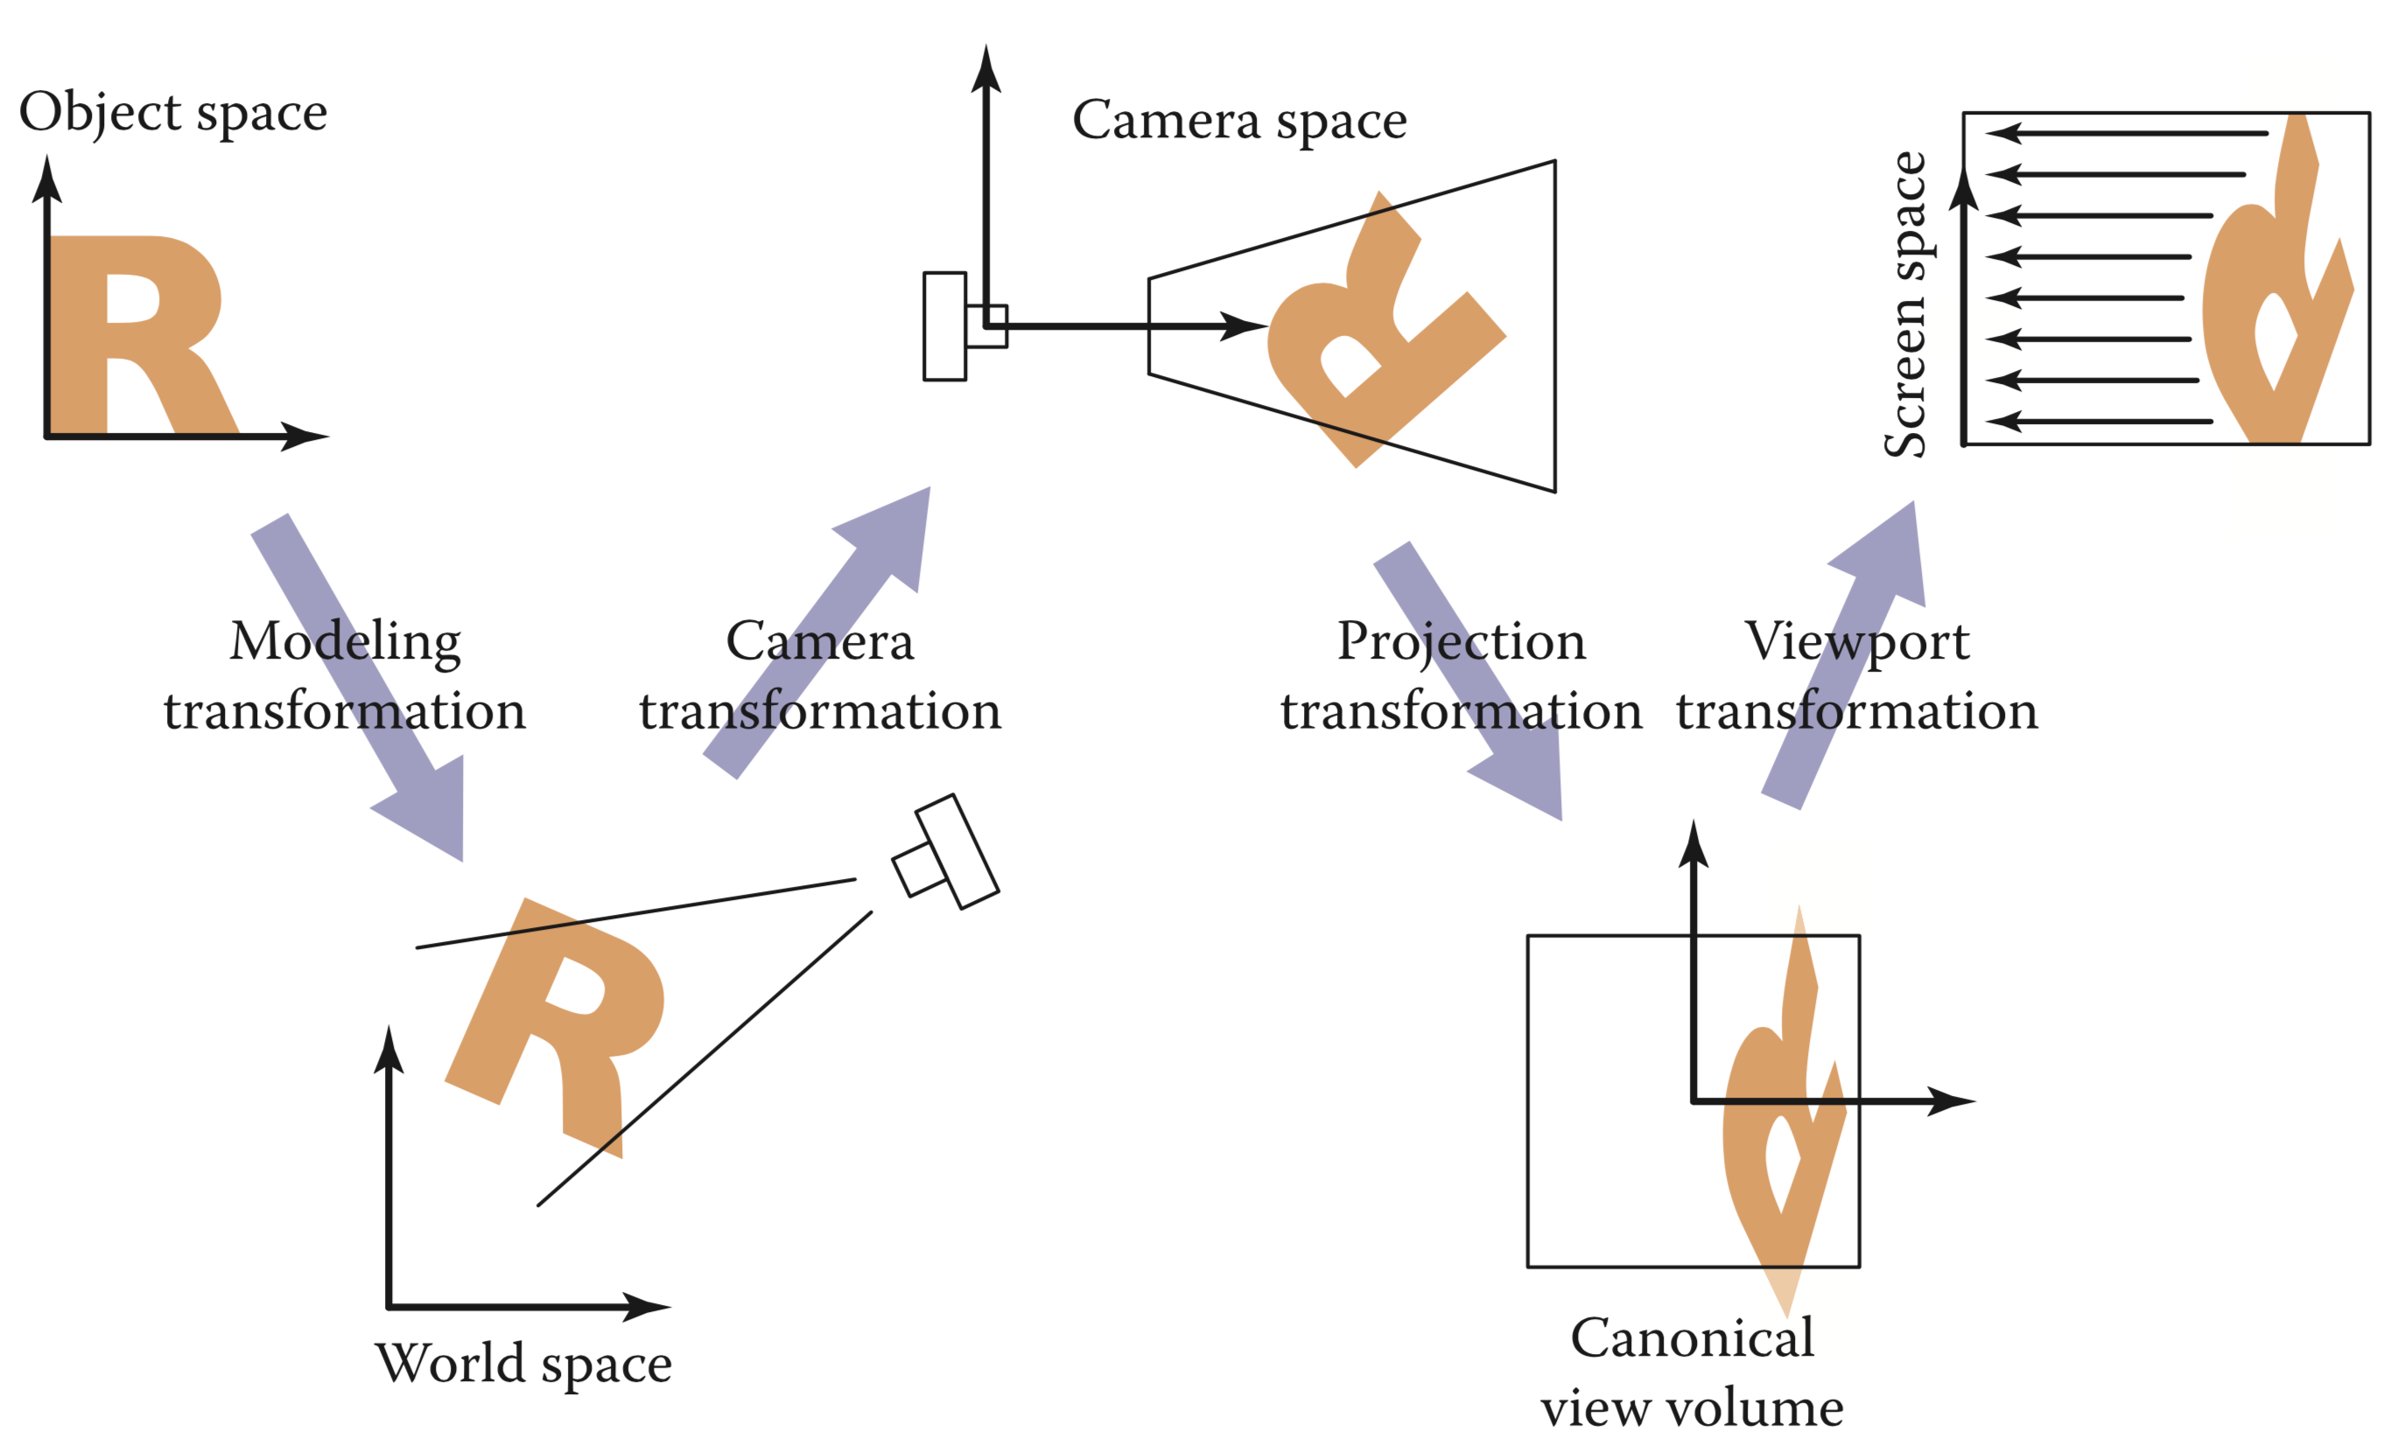
Step-by-Step Viewing Transformations
(Each arrow is a matrix)
We’ll Discuss Later

Slide 32
Viewport Transformation
Goal: Transform from a canonical 2D space to pixel coordinates
Canonical space: (xcanonical,ycanonical) ∈ [-1,1]×[-1,1]
Pixel space: Integers (xscreen,yscreen) ∈ [0 , nx ]×[0 , ny]
nx, ny. are the number of columns and rows
To be precise,
(xscreen,yscreen) ∈ [0.5,nx-0.5]×[0.5,ny-0.5]
Initially, we will think of this as transformation of a 2D to 2D space

Slide 33
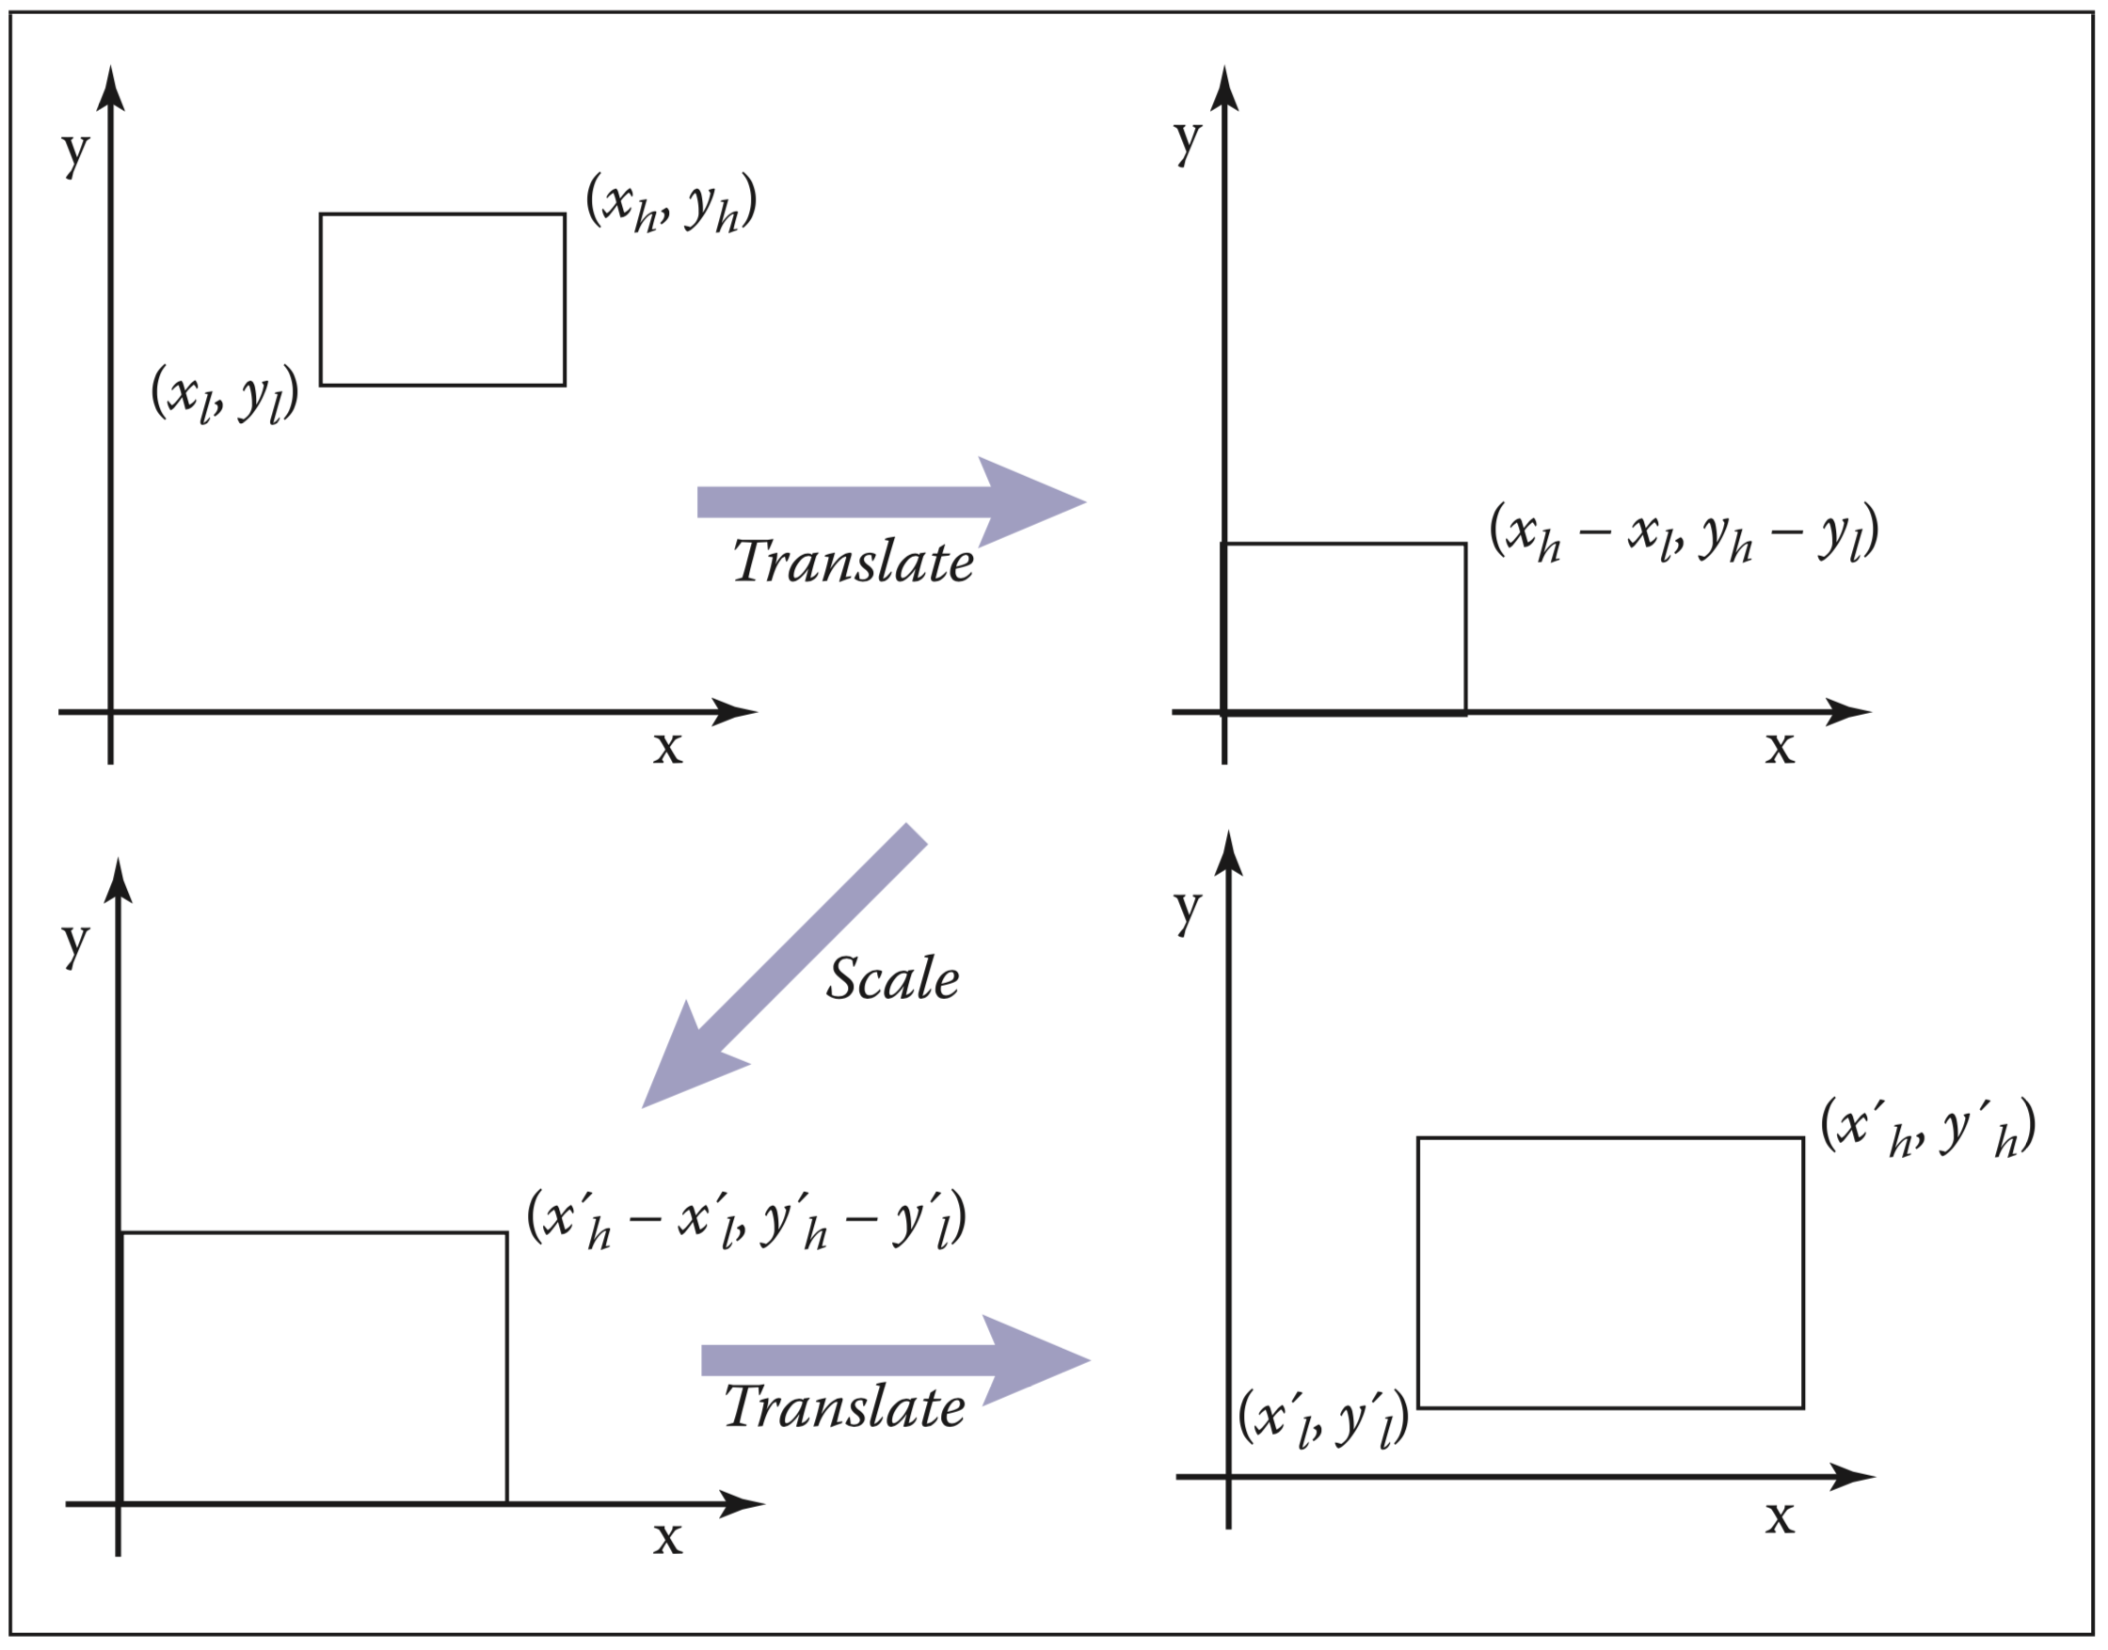
Viewports as Windowing
A windowing operation transforms a rectangle [𝑥l,𝑥h]×[𝑦l,𝑦h] to another rectangle [𝑥’l,𝑥’h]×[𝑦’l,𝑦’h]

Slide 34
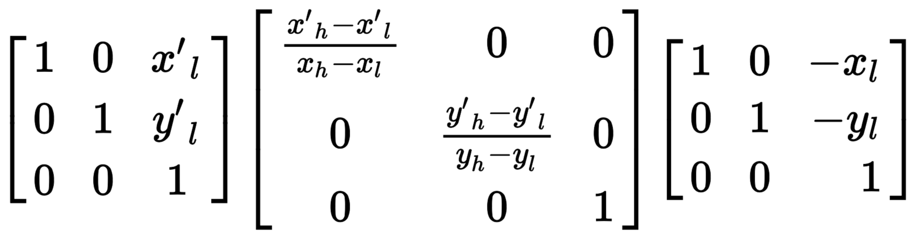
Viewports as Windowing
Decompose windowing into three steps

Slide 35
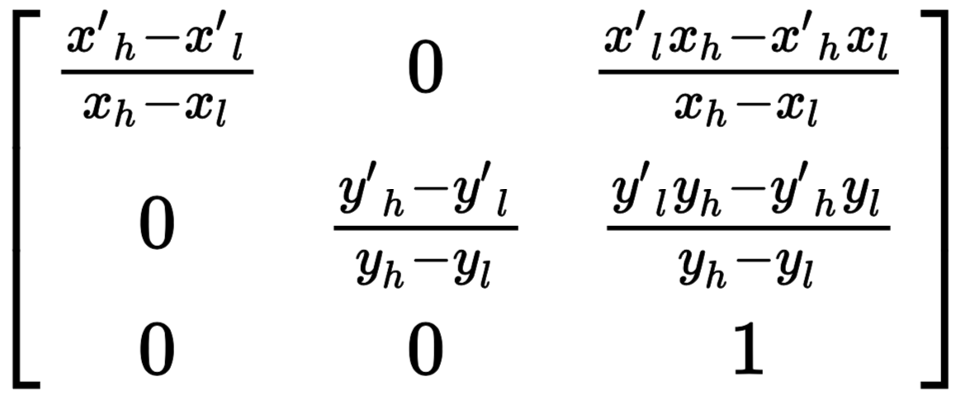
Viewports as Windowing
Multiplying together:

Slide 36
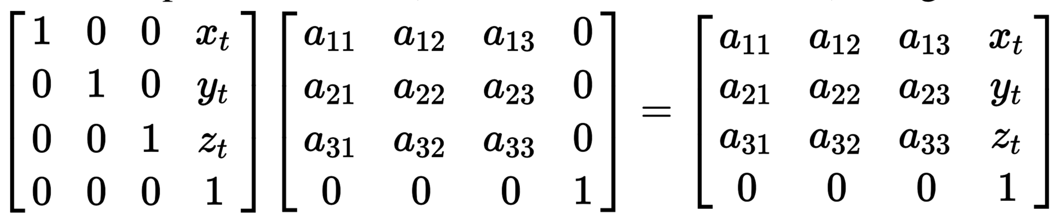
Sidebar: Combining a 3x3 Linear Matrix Followed by a Translation
Translation after the linear transformation can always be read off separately.
Often useful for debugging.

Slide 37
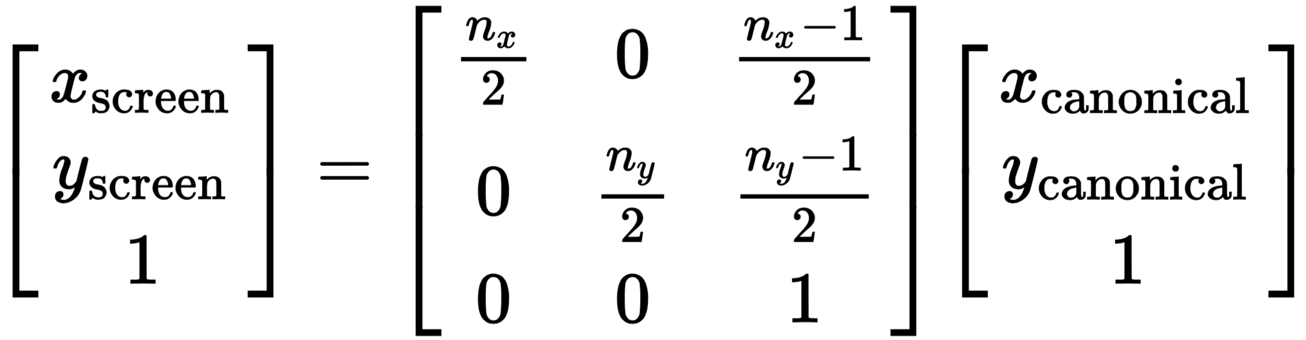
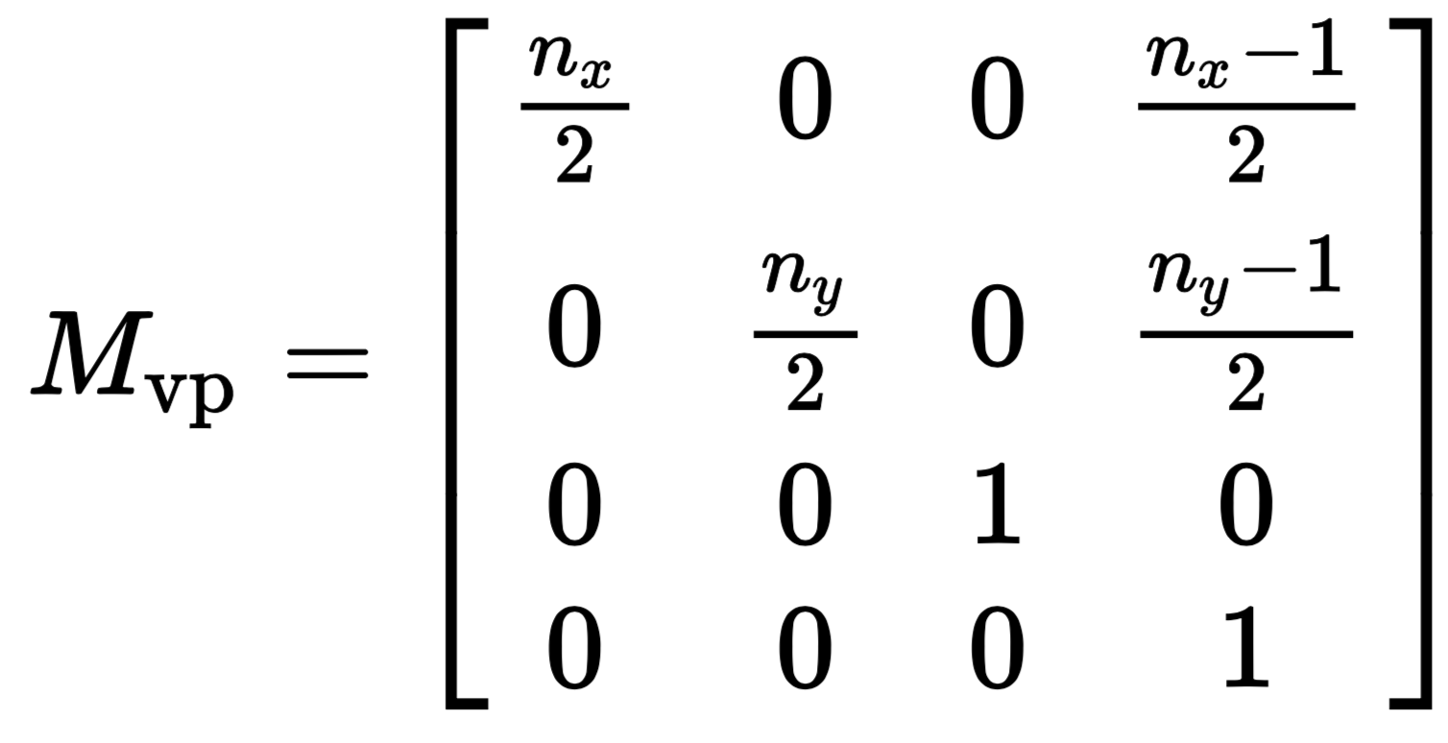
Using Windowing to define the Viewport Transformation
Plugging in with our known constants:
(recall - canonical are between [-1,1]. Screen in pixels)
Right now, we do not need z-values, but eventually we will need to carry them through with no changes:

Slide 38
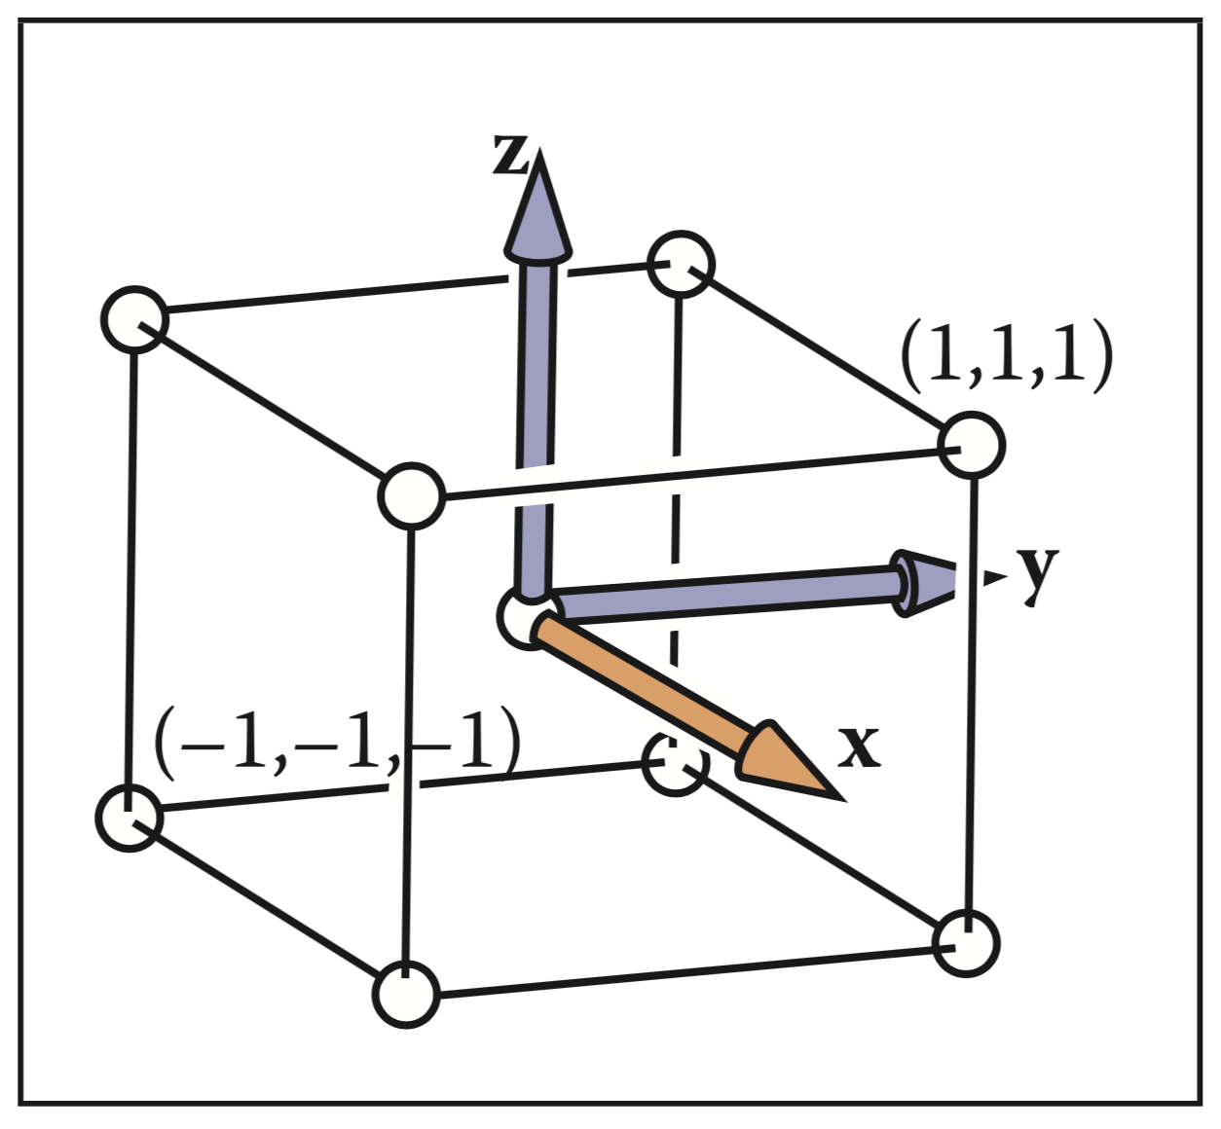
Canonical View Volume
In actuality, our viewport transformation will work with the canonical view volume

Slide 39
Orthographic Projection
Goal: Convert objects from 3D representation to canonical view volume
We will start by modeling this 3D space as an axis-aligned boxe
View volume: [𝑙,𝑟]×[𝑏,𝑡]×[𝑓,𝑛]
Canonical view volume: [-1,1]×[-1,1]×[-1,1]
Reshapes the view volume as defined by the camera

Slide 40
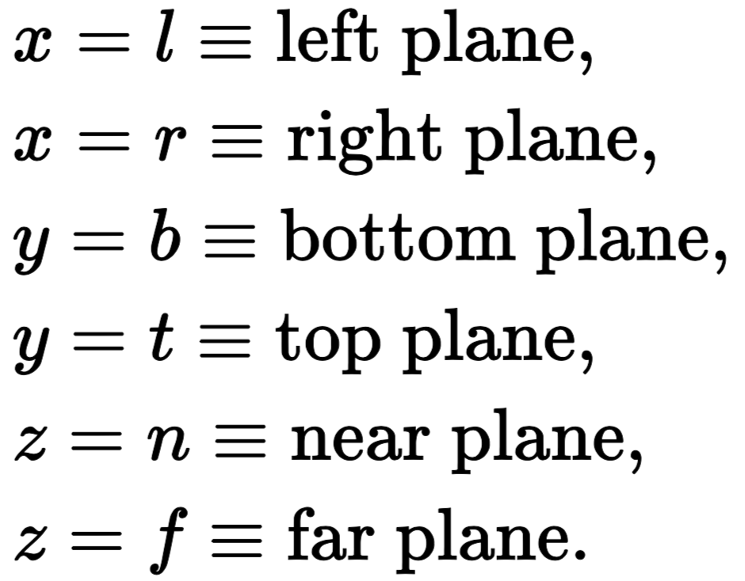
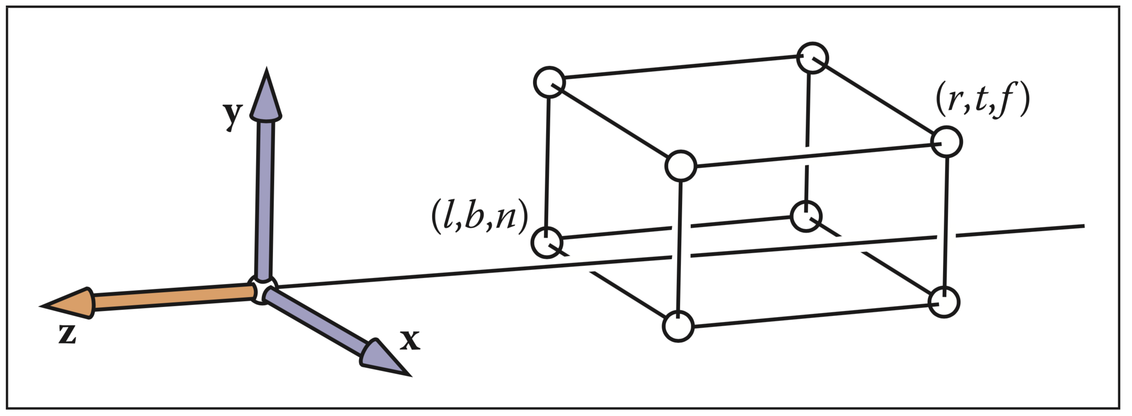
Orthographic Projection
Orthographic view volume defined by six scalars:
Convention: 𝑛 > 𝑓, but note that both are negative

Slide 41


Orthographic Projection
Just a 3D windowing transformation!

Slide 42
Camera Transformations
Goal: Transform 3D space to arbitrary camera parameters
Camera modeled with three vectors:
𝐞, the eye position
𝐠, the gaze direction
𝐭, the view up direction

Slide 43


Camera Coordinates
We will convert to a camera coordinate system with origin, 𝐞, and orthogonal basis vectors 𝐮, 𝐯, and 𝐰.
𝐞, the eye position
𝐠, the gaze direction
𝐭, the view up direction
=up

Slide 44

Camera Coordinates

Slide 45

Changing Coordinates
We need to both translate the origin and change coordinate systems

Slide 46
What is M_orth
Project points for (xyz) into (xy) ?
(x,y,z)-> (x,y,0)
(x,y,z,w)-> (x,y,0,w) ??
$$\left(\begin{matrix}1 & 0 & 0 & 0 \\ 0 & 1 & 0 & 0 \\ 0 & 0 & 0 & 0 \\ 0 & 0 & 0 & 1\end{matrix}\right)$$

Slide 47
Viewing Algorithm
construct M_vp
construct M_orth
construct M_cam
M = M_vp * M_orth * M_cam
for each 3D object O {
O_screen = M * O
draw(O_screen)
}
For example, if O is a triangle, with vertices 𝐚, 𝐛, and 𝐜, transform all 3 vertices 𝐌𝐚, 𝐌𝐛, and 𝐌𝐜

Slide 48
Projective Transformations

Slide 49


Relative Size Based on Distance
Key idea of perspective: the size of an object on the screen is proportional to 1/z
(xs,ys) are coordinates of the point (x,y,z) on the screen
xs is not shown
(x,y,z)

Slide 50

Using Homographies for Perspective
We can now replace:
With:

Slide 51


Perspective Matrix
Our matrix:
Keeps near plane fixed, maps far plane to back of the box

Slide 52

Perspective Distortion
Effect on view rays / lines:
Note that affine transformation cannot do this because it keeps parallel lines parallel

Slide 53

Perspective Distortion
Perspective matrix effect on coordinates is nonlinear distortion in z:
But it does, however, preserve order in the z-coordinate (which will become useful very soon)

Slide 54


Perspective Projection Matrix
Concatenating the perspective matrix with the orthographic projection provides the perspective projection matrix:
We can define 𝑙, 𝑟, 𝑏, and 𝑡 relative to the near plane, since we keep it fixed

Slide 55

Putting it all together
construct M_vp
construct M_per
construct M_cam
M = M_vp * M_per * M_cam
for each 3D object O {
O_screen = M * O
draw(O_screen)
}
Equivalently:
For a given vertex 𝐚 = (𝑥,𝑦,𝑧), p = 𝐌𝐚 should result in drawing (𝑥p/𝑤p,𝑦p/𝑤p,𝑧p/𝑤p) on the screen

Slide 56
The Graphics Pipeline
The sequence of operations that we’ll perform to transform from objects in 3D to color pixels on the screen.
A “pipeline” because there are many stages
All variants of object-ordered rendering follow a similar sequence to what we’ll discuss
Generally, there are plenty of opportunities for optimization in this and it can be much faster than raytracing with the right hardware

Slide 57
The Graphics Pipeline

Slide 58

Geometric primitives described by vertices
TODAY
Updated positions of vertices and computed per-vertex data
Primitives converted into fragments, one for each pixel that store interpolated per-vertex data
Fragments processed to compute final colors for each pixel

Slide 59
Geometric Primitives
Points, lines, and triangles only.
What about?
Curves/Text? Approximate them with chains of line segments
Polygons? Break them up into triangles
Curved surfaces? Approximate them with triangles
Using minimal primitives keeps the pipeline simple and uniform for efficiency.

Slide 60
Rasterization

Slide 61
Two Jobs of a Rasterizer
To enumerate the pixels that are covered by each primitive
To interpolate the values/attributes across the primitives, e.g. normals, colors, texture coordinates
Output: a set of fragments, one for each pixel.
Fragments live at a pixel and store the interpolated attributes.

Slide 62
Rasterizing Lines to Fragments w/ Point Sampling
Option 1: Fatten the line and decide which pixels hit the rectangle
Decide which pixels are turned on if their center is inside the line
Problem: line width is not kept constant

Slide 63
Rasterizing Lines to Fragments w/ Point Sampling
Option 1: Fatten the line and decide which pixels hit the rectangle
Decide which pixels are turned on if their center is inside the line
Problem: line width is not kept constant

Slide 64
Rasterizing Lines to Fragments w/ Point Sampling
Option 1: Fatten the line and decide which pixels hit the rectangle
Decide which pixels are turned on if their center is inside the line
Problem: line width is not kept constant

Slide 65
Rasterizing Lines to Fragments w/ Point Sampling
Option 1: Fatten the line and decide which pixels hit the rectangle
Decide which pixels are turned on if their center is inside the line
Problem: line width is not kept constant

Slide 66
Rasterizing Lines to Fragments w/ Point Sampling
Option 1: Fatten the line and decide which pixels hit the rectangle
Decide which pixels are turned on if their center is inside the line
Problem: line width is not kept constant

Slide 67


Slide 68

Bresenham’s Algorithm
Foundational algorithm in computer graphics while at IBM from
Published in 1965

Slide 69

Equations for a line
Given points (𝑥0,𝑦0) and (𝑥1,𝑦1), the implicit equation for the line is:
We’ll consider lines only defined in one octant: 𝑥0 ≤ 𝑥1 (otherwise, swap the points) and that the slope of the line, 𝑚 ∈ (0,1] where
But the same technique can be used for any octant

Slide 70
Bresenham’s Approach
Key idea: only turn on one pixel per column
Multiple variants of this algorithm, we’ll discuss the midpoint algorithm

Slide 71
Resolving Sampling Issues with the Midpoint Algorithm
Turn on only the pixel closest to the line in each column
But then, why use the rectangle at all?

Slide 72
Resolving Sampling Issues with the Midpoint Algorithm
Turn on only the pixel closest to the line in each column
But then, why use the rectangle at all?

